Slide 1
Data Mining
Ch 10: Cluster Analysis - 2
Examples of Density-based Methods
Parameters
Wan D. Bae, Ph.D.
baewd@hanyang.ac.kr

Slide 2
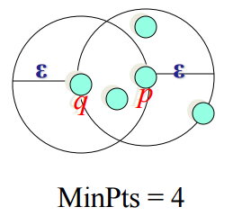
Density-reachability (Review)
Directly density-reachable:
  An object p is directly density-reachable from anther object q,
  w.r.t. Eps and MinPts iff p is in q’s ε-neighborhood
    q is a core object: |Nε (q)| ≥ MinPts
    p belongs to Nε (q)
Density-reachability is not symmetric
  q is not directly density-reachable from p
p
q

Slide 3
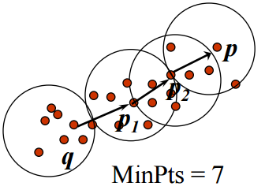
Density-Reachability (Review)
Density-reachable:
  An object p is density-reachable from another object q,
  w.r.t. Eps and MinPts iff there is a chain of points p₁, p₂ …, p_{n},
  p₁ = q and p_{n} = p such that p_{i+1} is directly density-reachable from p_{i}
  Example
    A point p is directly density-reachable from p₂
    p₂ is directly density-reachable from p₁
    p₁ is directly density-reachable from q
    p ← p₂ ← p₁ ← q form a chain
    p is (indirectly) density-reachable from q
    q is not density-reachable from p

Slide 4
Density-Connected (Review)
An object p₁ is density-connected to another object p₂, w.r.t. Eps and MinPts iff
  there is an object q such that both, p₁ and p₂ are density-reachable from q, w.r.t. Eps and MinPts
p₁
p₂
q

Slide 5
DBSCAN: The Algorithm
Arbitrary select an object o in D, if o is not processed;
  If o is a core point ( |Nε (o)| ≥ MinPts ), a cluster is formed
    Collect all objects density-reachable from o, w.r.t. Eps and MinPts
    (DBSCAN iteratively collects directly density-reachable objects)
    Merge of a few density-reachable clusters may occur
  If o is not a core object ( |Nε (o)| < MinPts ), o is considered to be noise and not added to any cluster.
    If this is not density-reachable from any core point, it stays as noise.
    If it is a border object, no objects are density-reachable from o and DBSCAN visits the next object of the database
Continue the process until all of the objects have been processed

Slide 6
Algorithm
DBSCAN(D, eps, MinPts)
C = 0
for each unvisited point P in dataset D
mark P as visited
N = regionQuery(P, eps)
if sizeof(N) < MinPts
mark P as NOISE
else
C = next cluster
expandCluster(P, N, C, eps, MinPts)
expandCluster(P,N,C,eps,MinPts)
add P to cluster C
for each point P' in N
if P' is not visited
mark P' as visited
N' = regionQuery(P', eps)
if sizeof(N') >= MinPts
N = N joined with N'
if P' is not yet member of any cluster
add P' to cluster C
Complexity with indexing structure: O(n*log(n))

Slide 7
An Example
ε
P₁
ε
ε
P
P
C₁
C₁
1. Check the ε-neighborhood of p
2. If p has less than MinPts neighbors then mark p as outlier and continue with the next object
3. Otherwise mark p as processed and put all the neighbors in cluster C₁
1. Check the unprocessed objects in C₁
2. If no core object, return C₁
3. Otherwise, randomly pick up one core object p₁ in C₁ mark p₁ as processed, and put all unprocessed neighbors of p₁ in cluster C
MinPts = 4

Slide 8
Determining the Parameters ε and MinPts
Idea: use the point density of the least dense cluster in the data set as parameters – but how to determine this?
Heuristic: look at the distances to the k-nearest neighbors
  For objects in a cluster, their k^{th} nearest neighbors (this k does not the same as k number of clusters, so you can say this is something p^{th} nearest neighbors) are at roughly the same distance
Function k-distance(p): distance from p to the its k-nearest neighbor
k-distance plot: k-distances of all objects, sorted in order
p
3-distance(p) :
q
3-distance(q) :

Slide 9
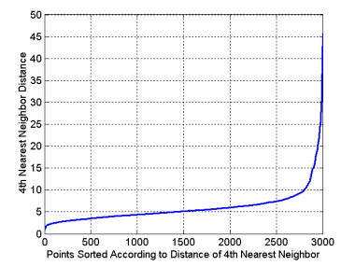
DBSCAN: Determining Eps and MinPts
Noise points have the k^{th} nearest neighbor at farther distance
So, plot sorted distance of every point to its k^{th} nearest neighbor
이 선을 기준으로 거리가 너무 멀어져있음을 의미한다.
4th는 mean point
10은 absolute border
4-distance plot
border object

Slide 10
Determining the Parameters ε and MinPts
Heuristic method:
  Fix a value for MinPts (default: 2 * d –1)
    Numerous experiments indicates best MinPts = 4 - 5
  User selects “border object” o from the MinPts-distance plot
    ε = MinPts-distance(o)

Slide 11
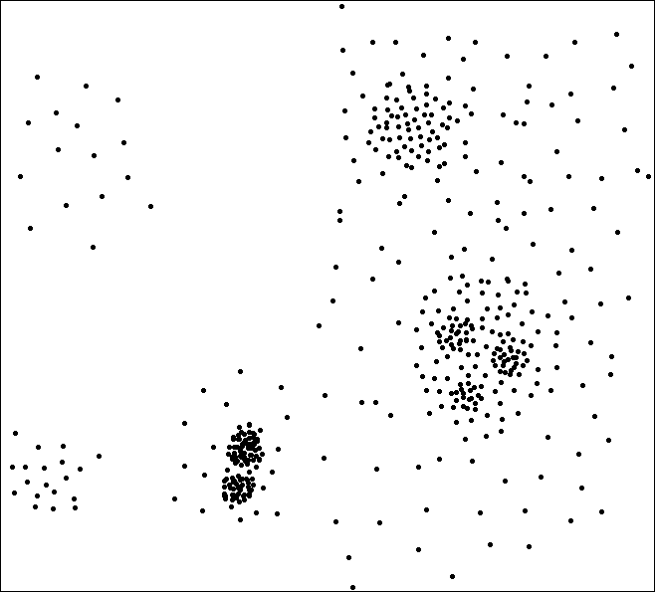

Determining the Parameters ε and MinPts
Problematic example
  Clustering datasets with large difference in densities
A
C
F
E
A, B, C
B, D, E
G
G1
B‘, D‘, F, G
G3
3-Distance
D
D1, D2,
G1, G2, G3
B
D’
G2
B’
D1
D2
Objects

Slide 12
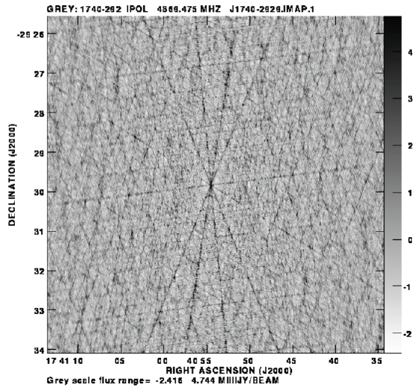
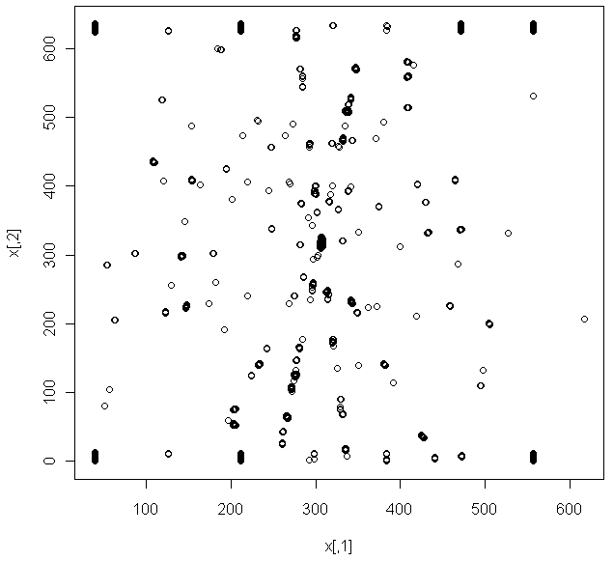
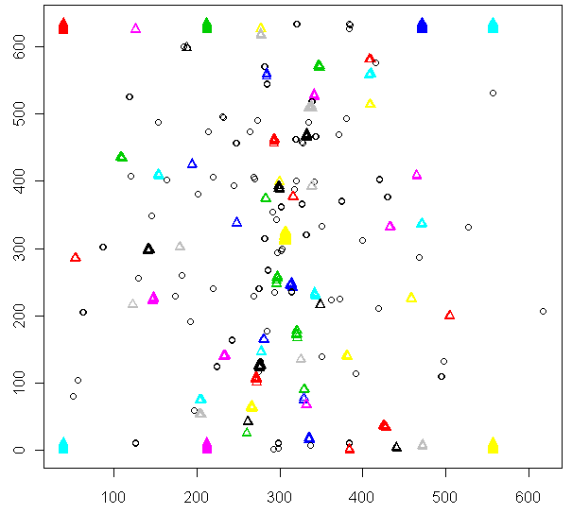
Example
Astronomy task
  Identifying celestial objects by capturing the radiation they emit
  Captured noise (by sensors, diffuse emission from atmosphere and space itself). To constrain the relevant intensity by a known threshold, only pixels whose intensity are less than 50 are being considered
DBSCAN algorithm applied on individual pixels
  Linking together a complete emission area
Each of the generated cluster will define a celestial entity
  ε = 5, MinPts = 5, 64 clusters and 224 outliers found

